Slide 1
Chapter 2
Database System Concepts and Architecture

Slide 2
Data Models
Data Model: A set of concepts to describe the structure of a database, and certain constraints that the database should obey.
Data Model Operations: Operations for specifying database retrievals and updates. Operations on the data model may include basic operations and user-defined operations.

Slide 3
Categories of data models
Conceptual (high-level, semantic) data models: Provide concepts that are close to the way many users perceive data. (Also called entity-based or object-based data models.)
Physical (low-level, internal) data models: Provide concepts that describe details of how data is stored in the computer.
Implementation (representational) data models: Provide concepts that fall between the above two, balancing user views with some computer storage details.

Slide 4
Schemas versus Instances
Database Schema: The description of a database. Includes descriptions of the database structure and the constraints that should hold on the database.
Schema Diagram: A diagrammatic display of (some aspects of) a database schema.
Schema Construct: A component of the schema or an object within the schema, e.g., STUDENT, COURSE.
Database Instance: The actual data stored in a database at a particular moment in time. Also called database state (or occurrence).

Slide 5
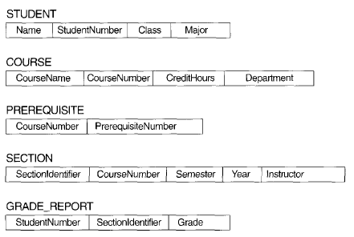
Schema diagram example

Slide 6
Three-Schema Architecture
Proposed to support DBMS characteristics of:
  Program-data independence.
  Support of multiple views of the data.

Slide 7
Three-Schema Architecture
Defines DBMS schemas at three levels:
  Internal schema at the internal level to describe physical storage structures and access paths. Typically uses a physical data model.
  Conceptual schema at the conceptual level to describe the structure and constraints for the whole database for a community of users. Uses a conceptual or an implementation data model.
  External schemas at the external level to describe the various user views. Usually uses the same data model as the conceptual level.

Slide 8
Three-Schema Architecture
Mappings among schema levels are needed to transform requests and data. Programs refer to an external schema, and are mapped by the DBMS to the internal schema for execution.

Slide 9
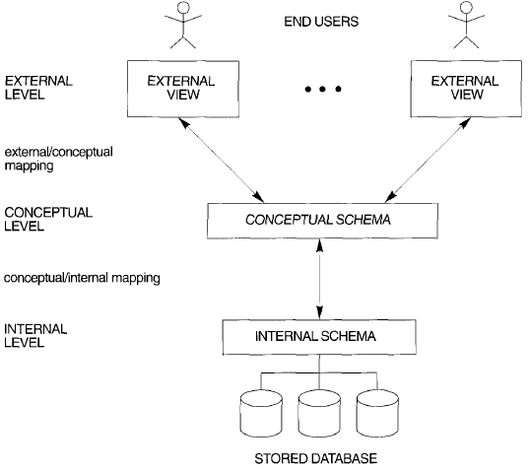

Slide 10
Data Independence
Logical Data Independence: The capacity to change the conceptual schema without having to change the external schemas and their application programs.
Physical Data Independence: The capacity to change the internal schema without having to change the conceptual schema.

Slide 11
Data Independence
When a schema at a lower level is changed, only the mappings between this schema and higher-level schemas need to be changed in a DBMS that fully supports data independence.
The higher-level schemas themselves are unchanged. Hence, the application programs need not be changed since they refer to the external schemas.

Slide 12
Basic Client-Server Architectures البنية الأساسية للعميل-الخادم
Specialized Servers with Specialized functions
Clients
DBMS Server

Slide 13
Specialized Servers with Specialized functions:
File Servers
Printer Servers
Web Servers
E-mail Servers

Slide 14
Clients:
Provide appropriate interfaces and a client-version of the system to access and utilize the server resources.
Clients maybe PCs or Workstations with disks with only the client software installed.
Connected to the servers via some form of a network.
(LAN: local area network, wireless network, etc.)

Slide 15
DBMS Server
Provides database query and transaction services to the clients
Sometimes called query and transaction servers

Slide 16

User Interface Programs and Application Programs run on the client side
Interface called ODBC (Open Database Connectivity) provides an Application program interface (API) allow client side programs to call the DBMS. Most DBMS vendors provide ODBC drivers.

Slide 17
Three Tier Client-Server Architecture
Common for Web applications
Intermediate Layer called Application Server or Web Server:
  stores the web connectivity software and the rules and business logic (constraints) part of the application used to access the right amount of data from the database server
  acts like a agent for sending partially processed data between the database server and the client.
Additional Features- Security:
  encrypt the data at the server before transmission
  decrypt data at the client

Slide 18
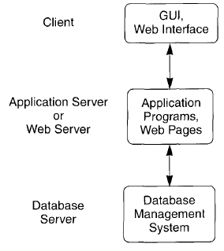
Logical three-tier client/server architecture

